Slide 1

Network-based Localization of Wi-Fi Devices
David Schunke
Supervisors: Nicolai Viol, Martin Henze
Bachelor Final Talk, Juni 2013
Notes:
Hi, I‘m David Schunke and this is my bachelor thesis final talk on the topic „network-based localization of Wi-Fi devices“.

Slide 2
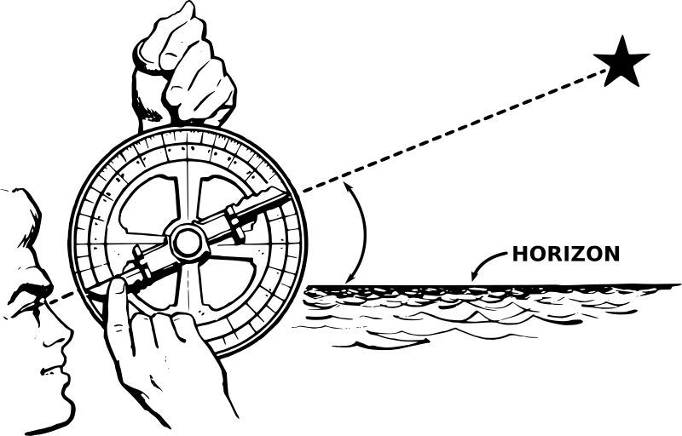
Motivation
Why indoor localization?
Outdoors: GPS
Line of sight
Accuracy up to few meters
Indoors: GPS not feasible
No line of sight
Typically higher accuracy required
Why network-based?
Independency from target device
No active participation imposed
Only few approaches on network-based localization
Simple & cheap deployment
New possible applications (e.g., surveillance)
Notes:
First, i want to give some motivation why it is interesting to work on this topic.
So why indoor localization?
In outdoor scenarios we have a state-of-the-art system namely GPS which can achieve an accuracy of up to few meters.
Unfortunately, GPS is not feasible for indoor scenarios because of the missing LOS dued to roofs and walls which decrease the accuracy.
And as there is typically a higher accuracy required for most indoor applications because of the tight structure, there is a demand for an indoor localization system that can achieve such an accuracy.
The second main topic is network-based.
The opposite would be a client-based system.
The difference is, in a client-based system the client that will be located takes part in the localization process.
In a network-based system, the participation of the client is removed which makes the system more indendent from the target.
This has two main advantages:
The deployment becomes simpler and thus also cheaper.
And it creates new possible applications such as a surveillance system which wouldn‘t be possible with a client-based solution.

Slide 3
Approach
Rely on existing Wi-Fi infrastructure
Use signal strength from the wireless network traffic
Access Points as data collectors
Only software-based approach
Rely on standard hardware
Challenges
How much wireless traffic is available?
How good is the localization?
Notes:
So in this approach, we have build a system that relied on a Wi-Fi infrastructure as Wi-Fi is nowadays a commonly used technology.
From this, we use the signal strength from the wireless network traffic as information source about the target device and use APs to collect that data.
And to make further hardware not required we based our system on software only, so it can be used on standard hardware.
So, we two major challenges in this approach:
First, is there enough wireless traffic and thus information about the target device available?
And second, how good is the estimated location of our system?

Slide 4

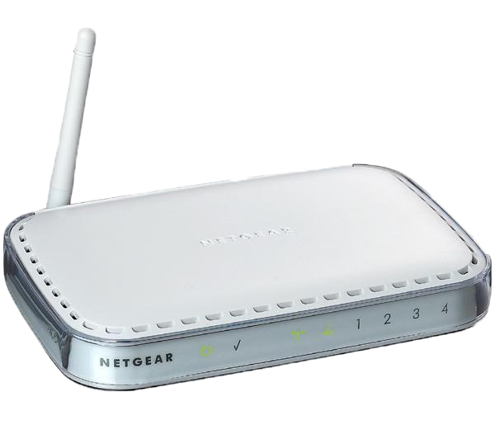
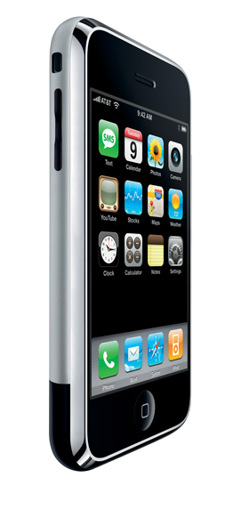
System Overview
Server
Merged data
Localization
Framework
RSS, time
RSS, time
.........
Sniffer 1
Sniffer n
Notes:
To bring you our system a bit closer, here is an overview.
We have the target device which can be stationary or mobile and emits wireless network traffic.
That traffic is captured by a number of sniffers which extract the received signal strength and timestamp and forward this data to a single server entity.
The server processes on the data and then sends the merged data to a localization framework which then performs the actual location estimation.
Pretty simple...
So, we can see in this system three major components.

Slide 5
Sniffer
Tasks
Collect signal strength data
Send data to Server
Implementation
Listen on channel with lowest signal strength value
Capture frames with Pcap
Extract data from radiotap header
Send data to Server via UDP
Notes:
The sniffers are implemented on APs and each has the tasks to collect the signal strength data from the wireless traffic and forward it to the server.
To fulfill these tasks the sniffer listens on the Wi-Fi channel on which it receives the lowest signal strength value.
The frame capturing is done with the pcap library using an additional radiotap header from the WNIC from which the signal strength can be obtained.
And finally the sniffer sends the data via UDP to the server.

Slide 6
Server
Tasks
Receive and process data simultaneously
Merge data from sniffers
Log data
Initialize localization
Implementation
Set up UDP socket
Group data in a time interval of 200ms
Log data to sqlite3 database
Send data to localization framework via HTTP POST
Notes:
This leads us to the server which has the tasks to be able to receive and process on the data simultaneously so it has to run asynchronously.
It has to merge the received data from the different sniffers, log all the information to be able to rerun the location estimation on exactly the same data, and finally it has to initialize the actual localization.
For these tasks, the server implements a UDP socket to receive the data from the sniffers.
It uses a buffer and a time interval of 200ms to process on the data. Each time interval represents one possible location estimation as long as at least one signal strength measurement is available, so this means we are able to calculate the location five times per second.
The data is logged to a sqlite3 database.
And finally the data is send to the localization framework what then initializes the localization process.

Slide 7
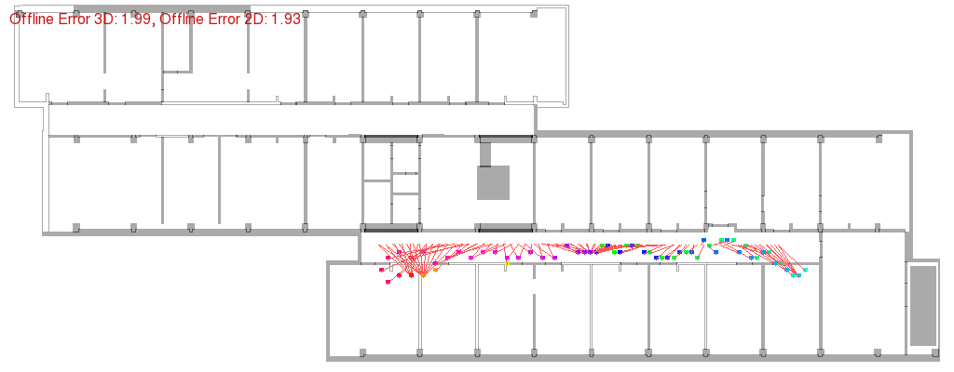
Localization Framework
Tasks
Perform actual localization
Give feedback of results
Implementation
Use priorly build localization framework
Used as „black box“
Requires scene configuration
Reference measurements
Positions of APs
Offers 3 methods with differences in online / offline calculation
Generates graphical output
Notes:
The last component is then the localization framework.
It tasks are to perform the actual loclaization and to give somehow back the results.
In this work we used a framework that has priorly been developed here at comsys.
As the development of this framework was not part of this work, we simply use it as kind of a “black box”.
But in the beginning the framework needs some information about the scene which means it requires reference measurements at different points in the environment at well known locations and also the positions of the APs have to be known.
It offers three different methods for the calculation and then gives back the results with even a graphical representation.
An example graphic can be seen here.

Slide 8
Evaluation
Traffic amount
Frame injection
Localization
Notes:
This was the system and now we come to the evaluation.
We have three points.

Slide 9
Evaluation – Traffic Amount
Why evaluating the traffic amount?
Network-based solution dependent from emitted wireless traffic
no localization when no traffic available
Evaluate emitted amount of standard devices
Apple MacBook Air running OS X 10.8
Apple iPhone 4s running iOS 6.1
Devices “idle”
5 minutes measurement period
Modes unassociated, associated and ad-hoc
Notes:
First we evaluated the amount of traffic a standard device emits.
This is interesting because with our network-based approach we are dependent from the traffic the target device emits by itself.
This means if the device does not transmit anything, we do not get any information and thus are not able to locate the target.
So we evaluated the amount of two standard devices, an Apple MacBook Air and an iPhone 4s.
We put both devices to an “idle” state which means both devices where online but we didn’t perform any additional tasks on the devices.
We recorded the traffic over a period of 5 minutes and in three different modes, unassociated, associated and in ad-hoc mode.

Slide 10
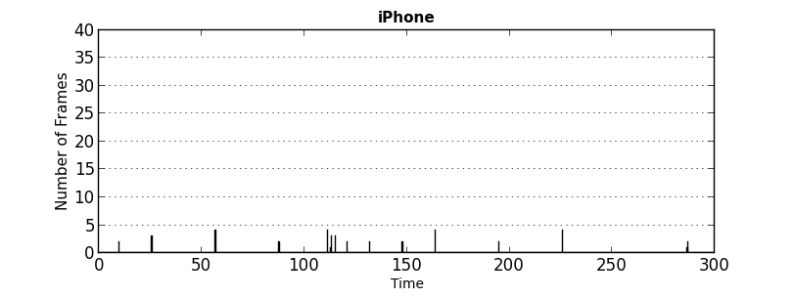
Evaluation – Traffic Amount
Unassociated
Frames / Iterations:
41 / 16
iPhone only few traffic by probe requests
MacBook no traffic at all
Notes:
First we take a look at the unassociated mode. The graphic show on the x-axis the time in seconds and on the y-axis the amount of data in each iteration.
For the iphone we can see only a few amount of traffic which come from probe requests that are automatically performed by the OS.
Overall there were 41 frames in 16 different iterations of the server available which means we would be able to estimate 16 out of 1500 possible locations.
For the MacBook it was even worse as there was no traffic at all.

Slide 11
Evaluation – Traffic Amount
Associated
Frames / Iterations:
199 / 36
Frames / Iterations:
812 / 237
Traffic amount due to background tasks
Notes:
In the associated mode the amount was higher.
The were 199 frames in 36 different iterations from the iphone and 812 frames in 237 iterations from the MacBook.
This traffic is dued to background tasks of the OS.

Slide 12
Evaluation – Traffic Amount
Ad-hoc
Frames / Iterations:
2908 / 1238
Frames / Iterations:
2974 / 1262
Both similar high amount due to network maintenance
Notes:
In the ad-hoc mode there was for both devices a high traffic amount as each device has to maintain its links and connections to other devices.
For both we received over 2900 frames in more than 1200 iterations out of 1500 possible iterations.

Slide 13
Evaluation – Frame Injection
Why evaluating frame injection?
Traffic amount can be insufficient for some applications
Depending on the mode and running tasks
Try to increase the emitted wireless traffic
Just give ideas, no sufficient full evaluation
Manually send packets addressed to the target device
Unassociated: IEEE 802.11 RTS and data frames
Associated: ICMP echo requests (ping)
Ad-hoc: not necessary
Flood transmissions
Only tested for iPhone 4s
Notes:
So the evaluation of the traffic amount has shown, that there are times in which we only receive few information which can be insufficient for some applications.
So we asked the question if it would be possible to some increase the amount.
But as this is not a main topic of this work, we just want to give some ideas on this.
We tried to manually send packets from an AP to the target device to maybe raise a reaction and encourage the target to transmit packets.
In the unassociated mode we tested RTS and data frames.
And in the associated mode we used ICMP echo requests also known as ping.
For the ad-hoc mode we assumed this as not necessary.
The transmissions are flooded and we tested it only for the iphone 4s.

Slide 14
Evaluation - Frame Injection
Unassociated
No noticeable increase
RTS frames
Data frames
Frames / Iterations:
21 / 12
Frames / Iterations:
9 / 4
56 / 19
16 / 6
Notes:
So for the RTS frames we see only a slight increase without sending the frames and with sending the frames.
As we flooded the RTS frames, we assumed that this increase is only comes from fluctuations in the interval the device sends probe requests.
The same here for the data frames, so we see no noticeable increase for these to methods.

Slide 15
Evaluation - Frame Injection
Associated
Amount significantly increased
Frames / Iterations:
274 / 76
Frames / Iterations:
2656 / 162
Notes:
Unlike in the associated mode for the ping method. As you may have expected, we could increase the amount, doubling the number of iterations with a evenly distribution.
But as I said, these were just ideas.

Slide 16
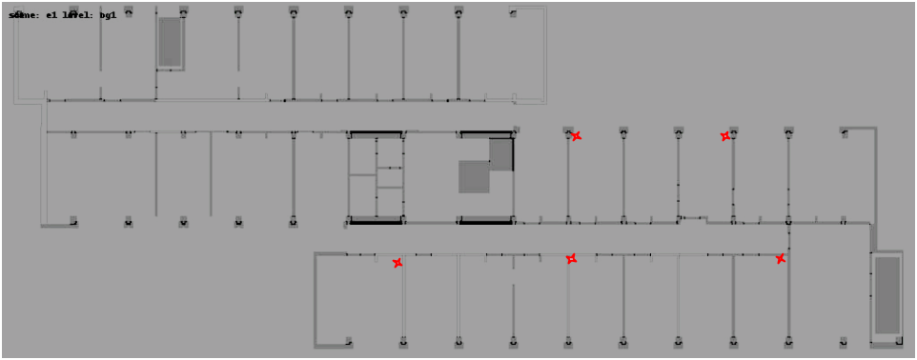
Evaluation - Localization
Scene
RWTH computer science building E1 1st floor
5 Sniffers, 3 different target devices
5 different paths, 10 measurements each path
simultaneously with all devices
stairs
stationary
Double-room
Single-room
floor
Notes:
Our last point is the actual localization.
First here is some information about the scene.
We did this at the first floor at the E1 building, so at the old place.
We deployed 5 sniffers and evaluated the localization for three different target devices.
We tested the localization traveling 5 different paths and taking measurements 10 times for each path.
And we did that with all three devices simultaneously so there where all the same environmental condtions for all devices.
This is a map of the floor, the red crosses mark the positions of the sniffers.
One path we called the floor path where we travelled along the floor.
Here we have all paths. Stationary means, we just stayed at one position and didn’t move at all.

Slide 17
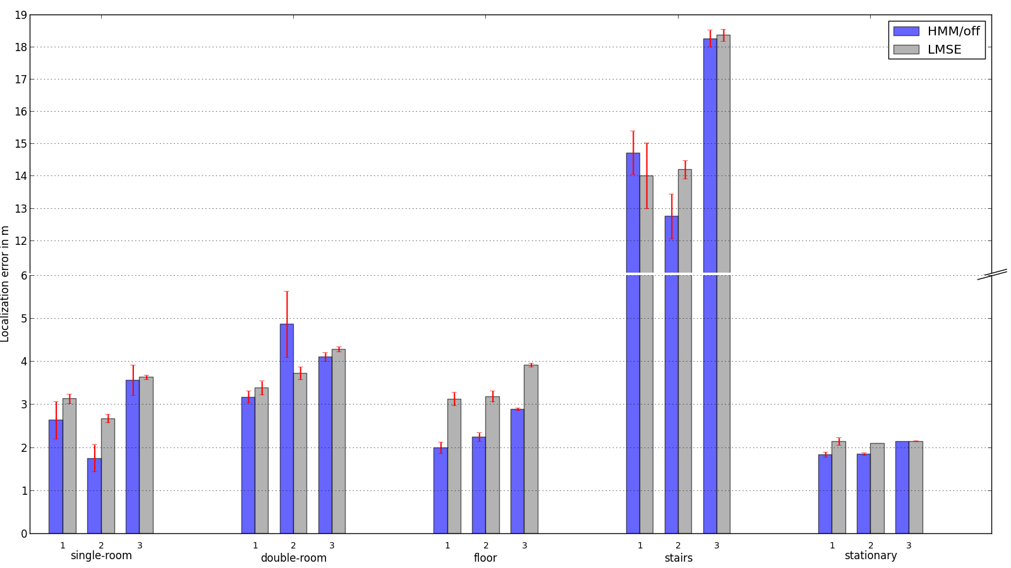
Evaluation - Localization
1: Atheros stick
2: MacBook Air
3: client-based
Minor differences between devices
Bad performance at the stairs
Notes:
These are the results of the localizations.
It is a lot information so let me guide you.
We have five blocks of bars which represent the five paths.
In each of these blocks there are again three blocks for the three different devices.
The first one is the device which we used to take the reference measurements for the framework.
The second is another device to test the adaptability of our system to different devices.
And the third is actually a client-based implementation.
So each of these pairwise bars shows the results for one device comparing two different methods the localization framework provides: blue hidden markov and grey LMSE.
For these four paths we see pretty good results with even less than 2m.
Only the stairs path stands out with an error between 13 and 18m.
Please note there is a cut in the y-axis and the value jumps directly from 6 to 11.
So we can see only minor differences between the devices, but the performance at the stairs path became insufficient for most applications.

Slide 18
Conclusion & Future Work
Conclusion
Achieved an accuracy of up to 1.75m
Comparable to client-based
Can be improved with additional Access Points
Adaptable to different target devices
Dependent on emitted traffic amount
Traffic amount depends on device
Future work:
Necessity for methods to increase the traffic amount when target device is unassociated
Additional information sources could improve the accuracy
Investigate counter measures
Notes:
Too conclude this work, with relatively low effort build a network-based indoor localization system that achieved an accuracy of up to 1.75m in our scene.
Especially, we were not worse than the client-based solution.
The performance could even be improved using additional APs, e.g., at the stairs.
We can locate different devices with comparable results.
But as we have seen, we are dependent on the emitted traffic amount, which also depends on the device.
For future work, it would be interesting to further investigate methods to somehow increase the traffic amount.
We could also use additional information sources.
As as our system enables applications like surveillance, counter measures on our system should be investigated because of privacy reasons.

Slide 19
Thanks for your attention!

